Slide 1

Pimpri Chinchwad College of Engineering
Pimpri Chinchwad Education Trust’s
Affiliated to Savitribai Phule Pune University, Pune and Approved by AICTE, New Delhi
Department of Electronics & Telecommunication Engineering
Smart Vehicle Accident Detection and Alert System Using IoT and Machine Learning
Project Group ID: C4_4
Group Members:
Project Guide:
124B2E030 Vivek Deshmukh
124B2E038 Vipul Jadhav
Dr. Ashwini Shinde
Pimpri Chinchwad College of Engineering, Pune

Slide 2
Outline of Project
Introduction
Literature Review
Need of the Project
Problem Statement and Objectives
SDGs Mapped
Methodology
Novelty
Future Scope
Expected Conclusion
References
AI-Based Vehicle Accident Detection and Monitoring Systems
2

Slide 3
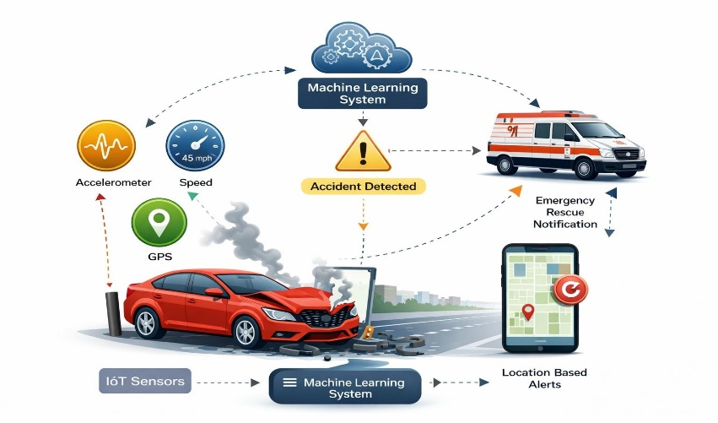
Introduction
Road accidents cause significant loss of life and property every year, making quick accident detection and emergency response essential for improving road safety. Traditional accident reporting methods rely on manual communication, which can delay rescue operations and medical assistance. With the advancement of IoT and embedded systems, vehicle parameters such as acceleration, speed, and location can be monitored in real time using various sensors. Machine learning techniques can analyze this sensor data to identify abnormal patterns and detect crash events accurately. The proposed system integrates IoT sensors, GPS, and machine learning to automatically detect accidents and send location-based emergency alerts, helping reduce response time and improve overall vehicle safety.
Fig. 1: Vehicle Accident Detection System
AI-Based Vehicle Accident Detection and Monitoring Systems
3

Slide 4
Literature Review
Sr. No. | Author(s) & Year | Title / Paper | Methodology / Approach | Findings / Results | Limitations / Gaps
1 | Singh et al. (2022) | IoT-Based Vehicle Accident Detection | Accelerometer and GSM detect crash impact and send GPS alerts | Real-time accident notification | Fixed threshold detection reduces accuracy
2 | Sharma & Patel (2021) | Smart Vehicle Black Box System | Embedded system logs speed, acceleration and GPS | Reliable crash evidence storage | No accident prediction capability
3 | Kumar et al. (2023) | AI-Based Driver Behavior Monitoring | Machine learning analyzes IMU driving patterns | Detects risky driving behaviors | Needs large datasets
4 | Zhang et al. (2022) | Edge AI Vehicle Safety System | Edge computing processes vehicle sensor data locally | Low latency decision making | Limited microcontroller power
5 | Reddy et al. (2020) | Smartphone Accident Detection | Smartphone IMU detects sudden impact | Low-cost crash detection | Phone orientation affects accuracy
AI-Based Vehicle Accident Detection and Monitoring Systems

Slide 5
Need of the Project
Road accidents often occur suddenly and victims may not be able to inform emergency services immediately.
Traditional accident reporting methods rely on manual communication, which can delay rescue operations.
Lack of real-time monitoring of vehicle conditions makes early accident detection difficult.
Sensor data such as acceleration, speed, and environmental conditions can provide important indicators of crash events.
Therefore, an IoT and Machine Learning based accident detection and prediction system is required to automatically identify accidents and send immediate alerts with location information.
AI-Based Vehicle Accident Detection and Monitoring Systems

Slide 6
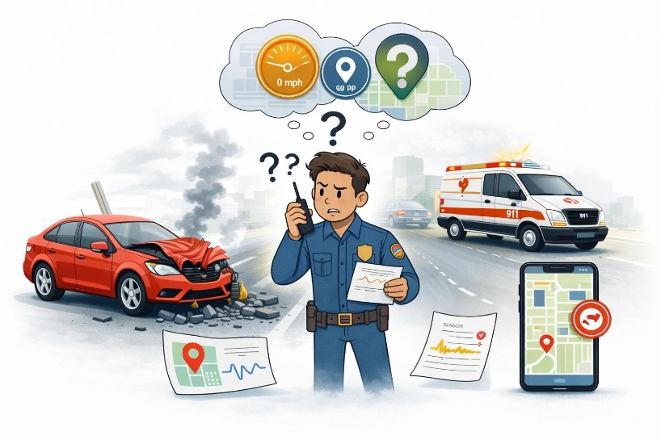
Problem Statement
Road accidents occur frequently, and in many cases there is limited information available about the exact cause of the crash. Most vehicles do not record important parameters such as speed, motion data, or location, which can delay rescue operations and complicate insurance investigations. Without reliable data, it becomes difficult to determine what actually happened during the accident. This project addresses this problem by developing an intelligent system that continuously monitors vehicle conditions using sensors and machine learning. The system can detect accidents automatically, send emergency alerts with GPS location, and securely record accident-related data to support faster response and fair analysis.
Fig. 2 Problem statement
AI-Based Vehicle Accident Detection and Monitoring Systems

Slide 7
SDGs Mapped
Sustainable Development Goals Related to the Project
Good Health and Well-Being The system helps reduce fatalities by automatically detecting accidents and sending emergency alerts for faster medical assistance.
Industry, Innovation and Infrastructure The project integrates IoT sensors, GPS, and machine learning to develop an intelligent vehicle safety monitoring system.
Sustainable Cities and Communities By improving accident detection and response time, the system contributes to safer and smarter transportation systems.
Partnerships for the Goals The system enables coordination between emergency services, hospitals, and authorities for quicker accident response.
AI-Based Vehicle Accident Detection and Monitoring Systems

Slide 8
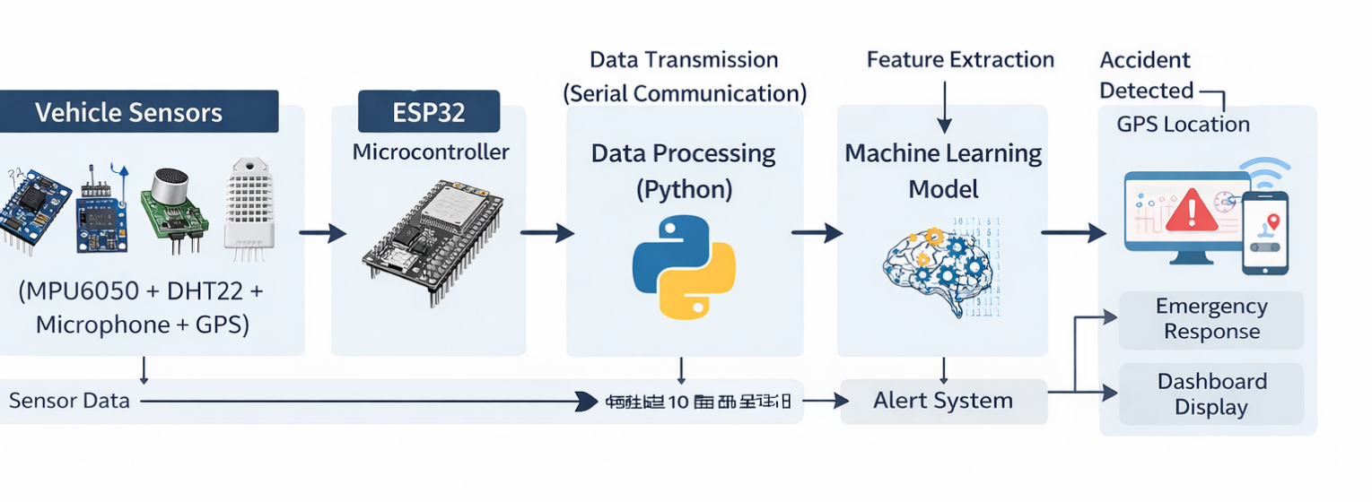
System Architecture
The system architecture shows how sensor data is collected, processed, and used to detect accidents. Vehicle sensors such as the MPU6050, DHT22, microphone, and NEO-7M GPS Module continuously monitor vehicle motion and environmental conditions. The data is sent to the ESP32, which transmits the information to a computer system for processing. A machine learning model developed using Python analyzes the sensor data to detect abnormal patterns indicating an accident. When a crash is detected, the system retrieves the GPS location and generates an alert with the exact location for quick emergency response.
Fig 3. System Architecture
AI-Based Vehicle Accident Detection and Monitoring Systems

Slide 9
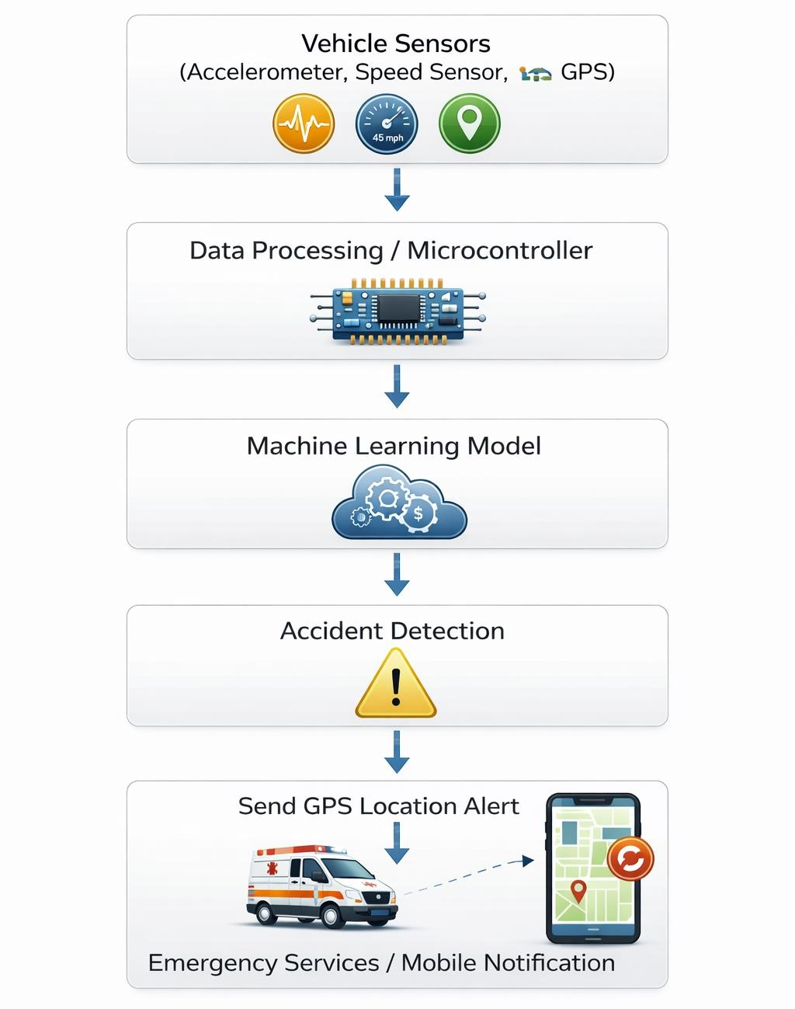
Methodology
Fig 4.Flowchart
AI-Based Vehicle Accident Detection and Monitoring Systems
14

Slide 10
Methodology
Dataset Collection
• MPU6050 collects acceleration and gyroscope data • GPS collects location and speed • DHT22 records environmental data • Microphone detects crash sound
2. Data Processing
• The collected sensor readings are converted into a structured numerical dataset
• Noise and unwanted fluctuations in the sensor data are removed to improved
• Data normalization and scaling are applied to ensure consistent values for accurate model training.
• The processed dataset is then used to train the machine learning model for accident detection and prediction.
AI-Based Vehicle Accident Detection and Monitoring Systems

Slide 11
Methodology
3. Machine Learning Model Training
The extracted features are used to train machine learning algorithms such as
Random Forest
Decision Tree
4. Prediction and Evaluation
The performance of the model is evaluated using the following metrics:
• Accuracy – Measures the overall correctness of accident predictions. • Precision – Indicates how many predicted accidents are actually true accidents. • Recall – Measures how effectively the model detects actual accident events.

Slide 12
Methodology
5.Accident Detection Logic
System continuously monitors sensor values.
If thresholds are exceeded (high impact, sudden stop, loud sound),the system classifies it as a possible accident.
6.Alert Generation
After detection, the system automatically:
Sends GPS location
Generates emergency alert message.
7.Notification System Alert is sent to
Emergency contacts / ambulance
Mobile dashboard / web dashboard
Authorities if required.

Slide 13
Novelty of the Project
• Integration of Multiple Sensors The system combines motion, environmental, and sound sensors to monitor vehicle conditions more accurately.
• Machine Learning Based Accident Detection Unlike traditional threshold systems, a machine learning model analyzes sensor patterns to detect accidents more intelligently.
• Real-Time Monitoring System The system continuously collects and processes sensor data for instant crash detection.
• Automatic GPS-Based Location Sharing When an accident occurs, the system automatically sends the exact location for faster emergency response.
AI-Based Vehicle Accident Detection and Monitoring Systems

Slide 14
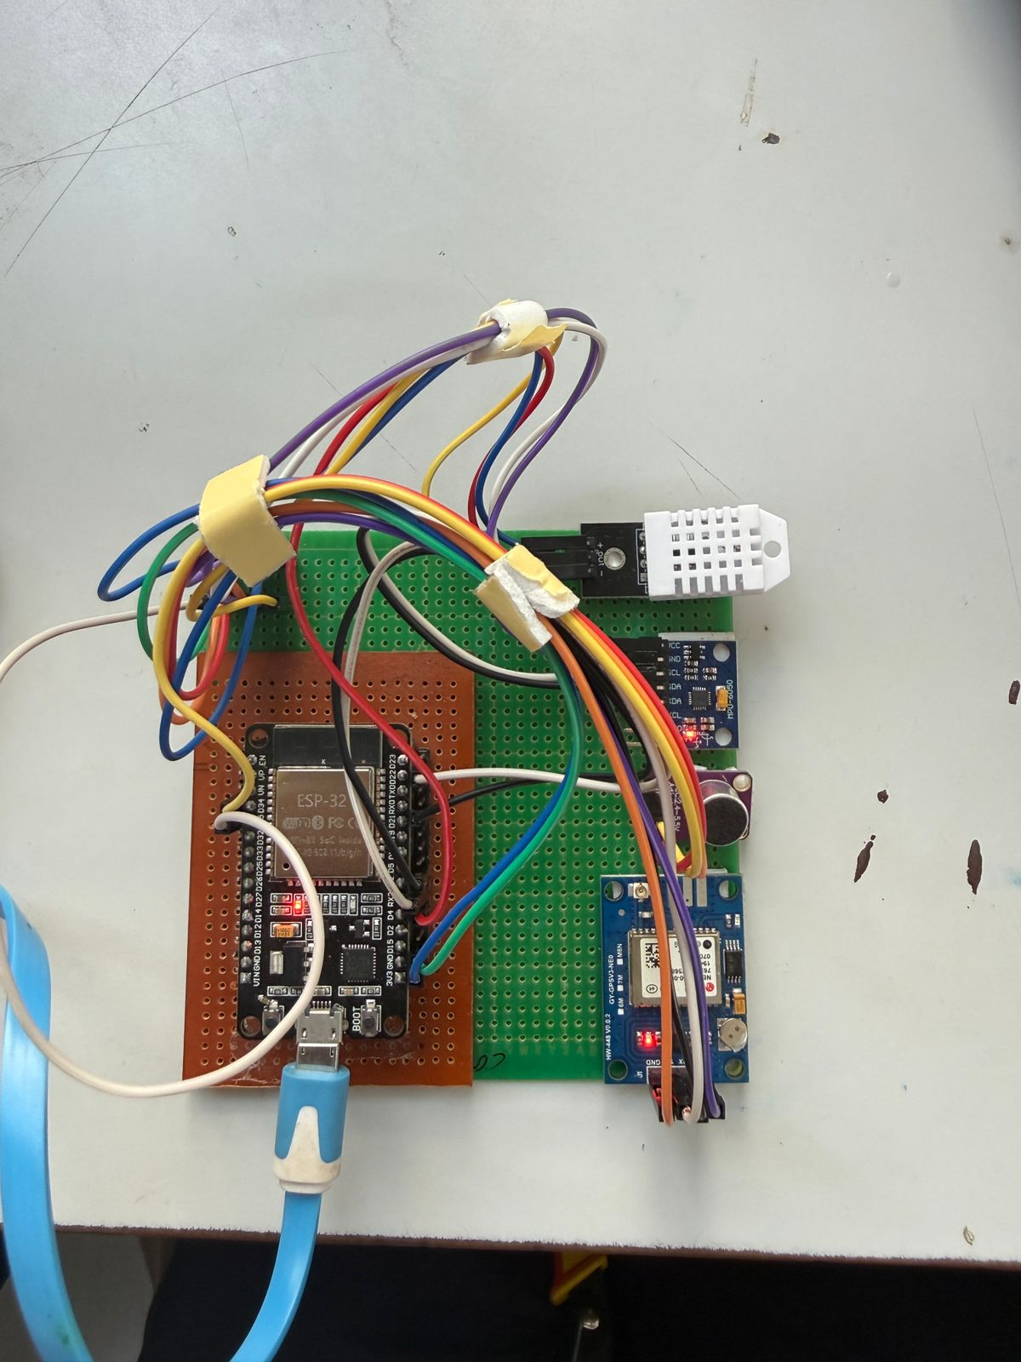
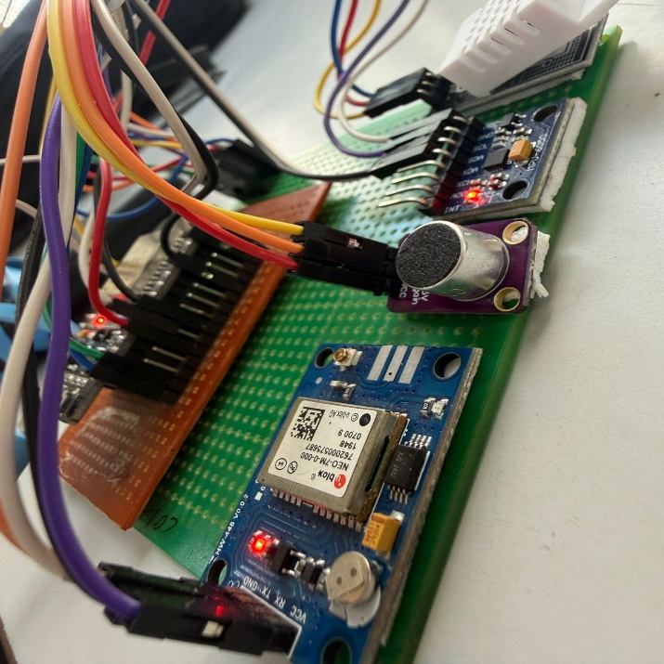
Circuit Implementation
Fig 5.Proposed System

Slide 15
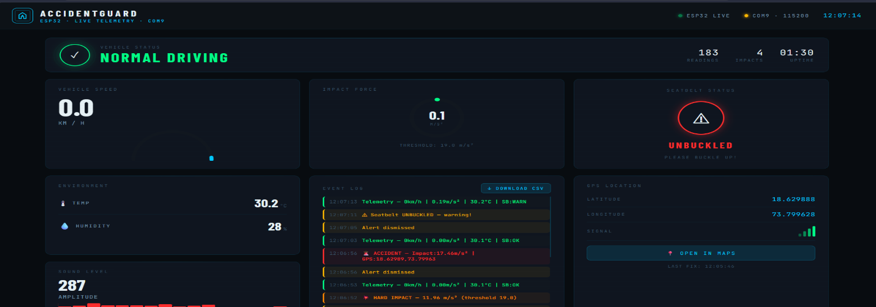
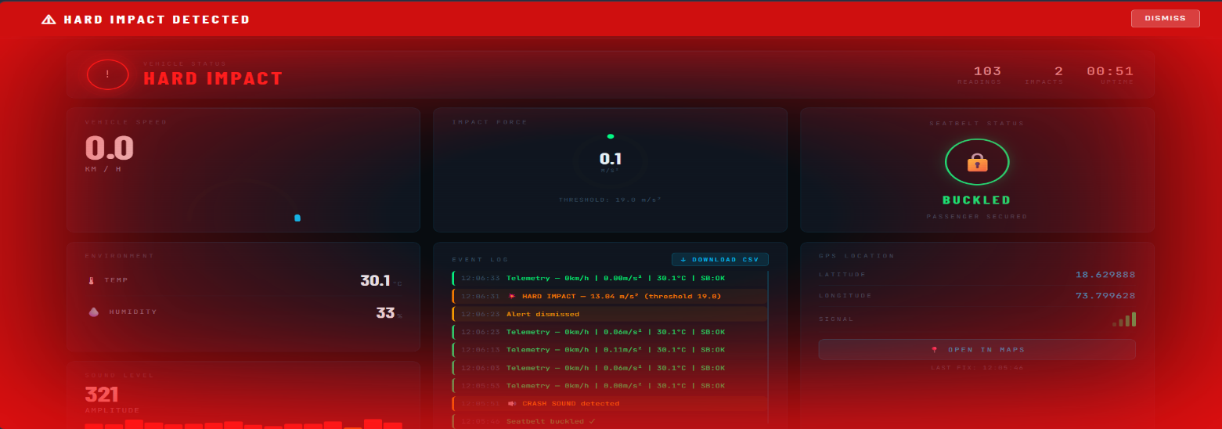
Result
1.Normal Driving
2.Hard Impact
AI-Based Vehicle Accident Detection and Monitoring Systems
15

Slide 16
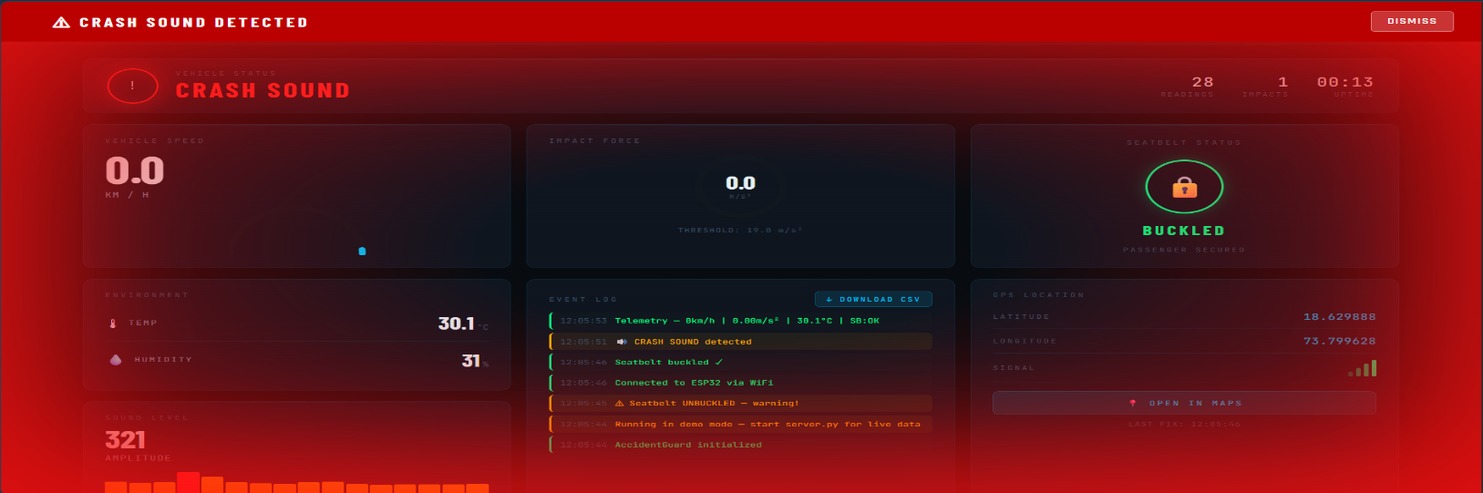
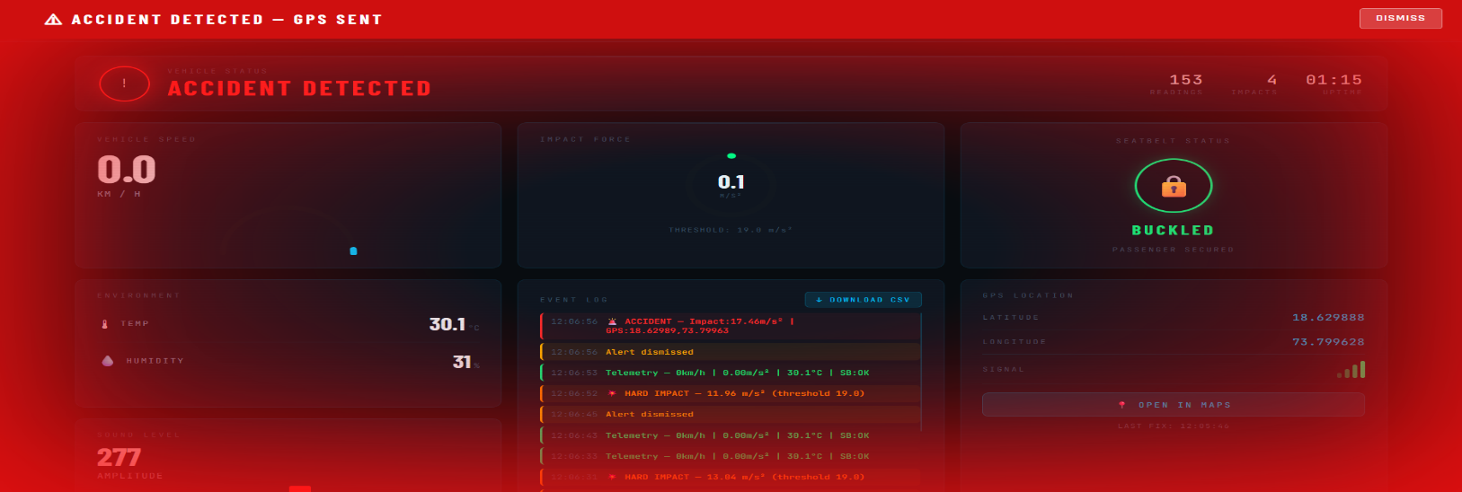
Result
3.Crash Sound
4.Accident Detected
AI-Based Vehicle Accident Detection and Monitoring Systems

Slide 17
Future Scope
• Integration with Smart City Infrastructure The system can be connected with traffic management and emergency services to provide faster accident response.
• Mobile Application for Real-Time Monitoring A dedicated mobile app can allow users, family members, and authorities to track vehicle status and receive instant alerts.
• Advanced AI Models for Better Prediction Future versions can use deep learning models to improve accident prediction accuracy and analyze driving patterns.
• Cloud-Based Data Storage and Analytics Accident data can be stored in the cloud for long-term analysis, insurance verification, and safety research.
AI-Based Vehicle Accident Detection and Monitoring Systems

Slide 18
Conclusion
The AI-based vehicle accident detection system provides an efficient solution for improving road safety and reducing emergency response time. By integrating IoT sensors, GPS technology, and machine learning techniques, the system can accurately detect accident events and automatically send alerts with location details. This helps emergency services respond quickly and potentially save lives. The proposed system demonstrates how intelligent technologies can be used to enhance transportation safety and real-time monitoring.

Slide 19
References
[1] S. Sharma and R. Singh, “IoT Based Vehicle Accident Detection and Alert System,” International Journal of Engineering Research & Technology (IJERT), vol. 8, no. 5, pp. 1023–1027, May 2019.
[2] A. Kumar and P. Gupta, “Smart Accident Detection and Reporting System Using IoT,” in Proceedings of the IEEE International Conference on Smart Computing, 2020, pp. 215–220.
[3] S. Patil and V. Patil, “Automatic Vehicle Accident Detection and Messaging System Using GPS and GSM,” International Journal of Advanced Research in Computer Engineering and Technology (IJARCET), vol. 6, no. 4, pp. 456–460, Apr. 2017.
[4] World Health Organization, Global Status Report on Road Safety, Geneva, Switzerland: WHO Press, 2018.
AI-Based Vehicle Accident Detection and Monitoring Systems
19

Slide 20
References
[5] Python Software Foundation, “Python Language Reference,” Available: https://www.python.org
[6] R. K. Sharma, “Accident Detection and Emergency Alert System Using Sensors,” International Journal of Electronics and Communication Engineering, vol. 9, no. 2, pp. 55–60, 2017.
[7] N. K. Gupta and S. Jain, “Smart Vehicle Accident Detection System Using Machine Learning,” International Journal of Engineering and Advanced Technology, vol. 9, no. 1, pp. 102–107, 2019.
[8] V. Singh and P. Sharma, “AI-Based Road Accident Detection System,” IEEE International Conference on Artificial Intelligence and Smart Systems, 2021.
[9] World Health Organization, Global Status Report on Road Safety, Geneva, Switzerland: WHO Press, 2018.
AI-Based Vehicle Accident Detection and Monitoring Systems
20

Slide 21
References
[11] Python Software Foundation, “Python Language Reference Manual,” Available: https://www.python.org
[12] TinyGPS++ Library Documentation, “GPS Parsing Library for Embedded Systems,” Available: https://github.com/mikalhart/TinyGPSPlus
[13] Streamlit Inc., “Streamlit Documentation for Data Apps,” Available: https://streamlit.io
[14] M. R. Islam and S. Hossain, “Machine Learning Based Road Accident Prediction and Detection System,” IEEE Access, vol. 8, pp. 134234–134245, 2020.
[15] J. Chen, Y. Wang and H. Li, “Deep Learning-Based Traffic Accident Detection in Intelligent Transportation Systems,” IEEE Transactions on Intelligent Transportation Systems, vol. 22, no. 7, pp. 4321–4332, 2021.
AI-Based Vehicle Accident Detection and Monitoring Systems

Slide 22
THANK YOU!
AI-Based Vehicle Accident Detection and Monitoring Systems
21

